Slide 1

Optimization Algorithms
Adam optimization
algorithm
deeplearning.ai

Slide 2
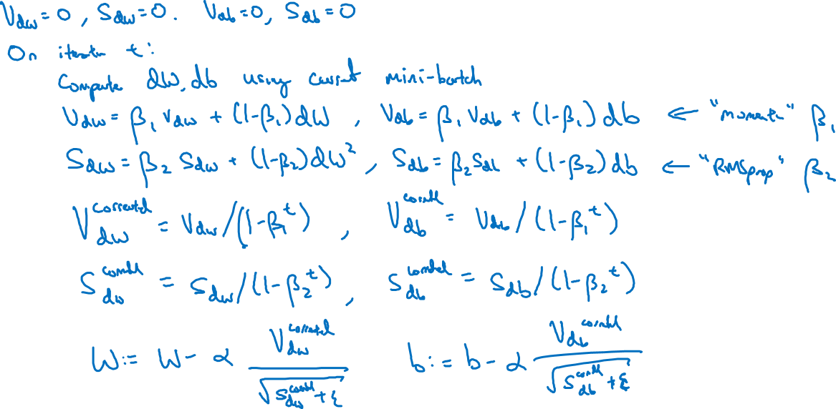
Adam optimization algorithm

Slide 3

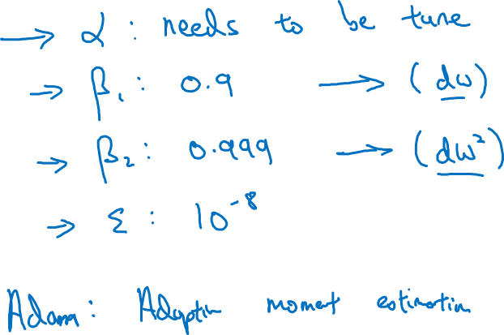
Hyperparameters choice:
Adam Coates

